Slide 1
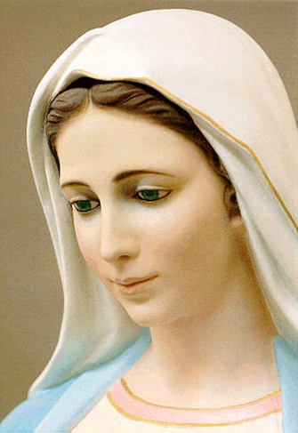
The Infancy Narratives cont.
Mary’s Role

Slide 2
Words to Know
Doctrine
  The revealed teaching of Christ which the Magisterium of the Church has declared Catholics are obliged to believe.
Assumption
  Mary’s being taken, body, and soul into heaven.
Immaculate Conception
  The church teaching that Mary was free from original sin from the first moment of her life.
Virgin Birth
  The Catholic doctrine that Mary conceived and gave birth to Jesus solely through the power of the Holy Spirit

Slide 3
Titles of Mary:
All refer to the Mother of Christ
Some are based on miracles that occurred dealing with Mary appearing or interceding

Slide 4
Theotokos:
Means “God-bearer”
Refers to Mary as the Mother of God

Slide 5
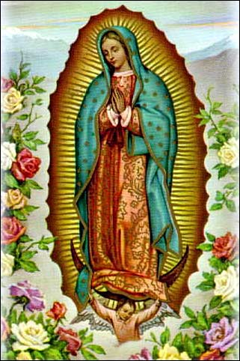
Our Lady of Guadalupe — This is the image Mary left on the cloak of Juan Diego. Our Lady called herself coatlaxopeuh, which means "the one who crushes the serpent." The word is pronounced "quat-la-supe," from which is derived the English version of "Guadalupe."

Slide 6
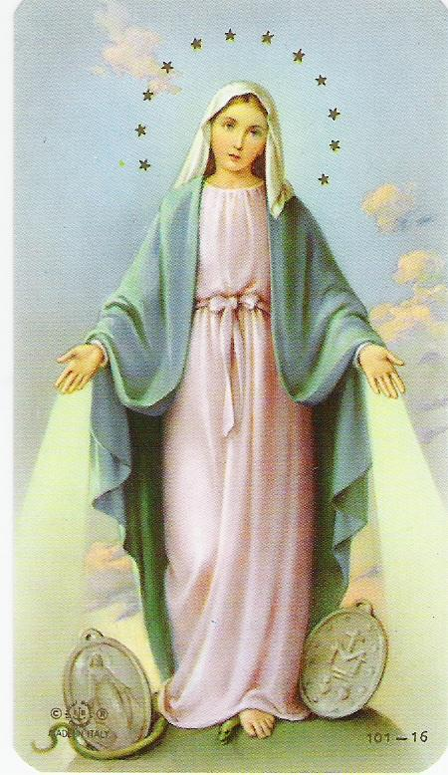
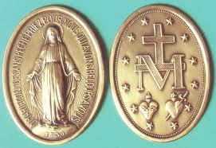
Our Lady of the Miraculous Medal — Mary's appearances to Catherine Laboure in 1830 marked the beginning of modern Marian apparitions. Mary gave Sr. Catherine the design for this medal. The words on the medal prompted clarification on the Immaculate Conception, which became dogma in 1854.

Slide 7
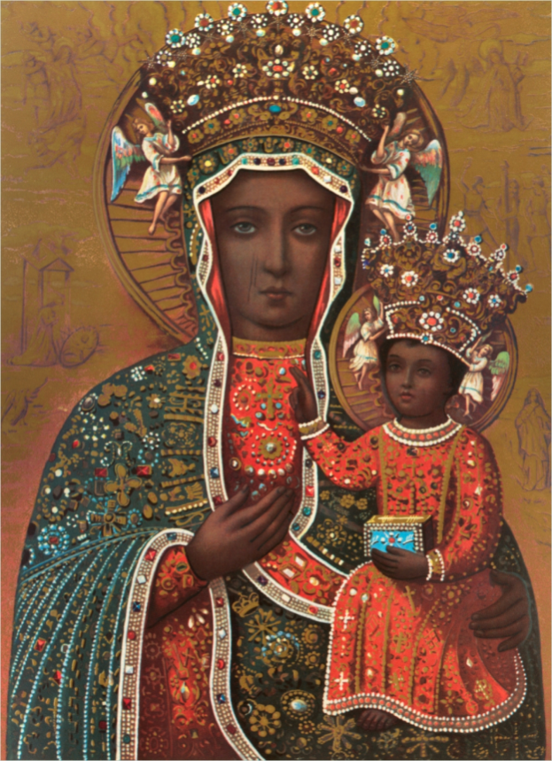
Our Lady of Czestochowa, or The Black Madonna — Poland's national shrine to Mary. Legend has it that St. Luke painted this icon on a table that Jesus built. Popes and pilgrims alike have recognized the miraculous nature of the image.

Slide 8
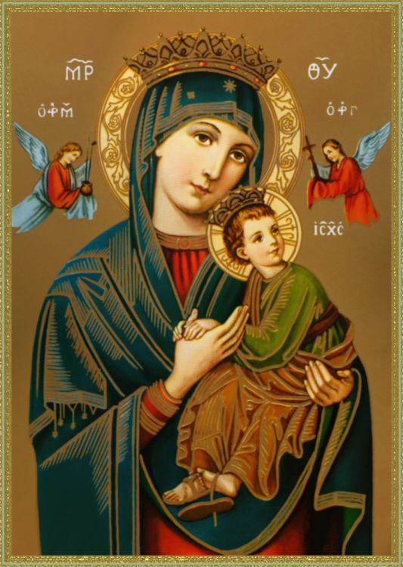
Mother of Perpetual Help — This painting shows the Madonna and Child attended by the archangels Michael and Gabriel. The angels hold instruments central to the Passion. The painting is heart breaking. The Christ Child, having glimpsed the instruments of torture, runs to His mother's protection. His right foot is bare, indicating He was so frightened He ran out of his sandal.

Slide 9
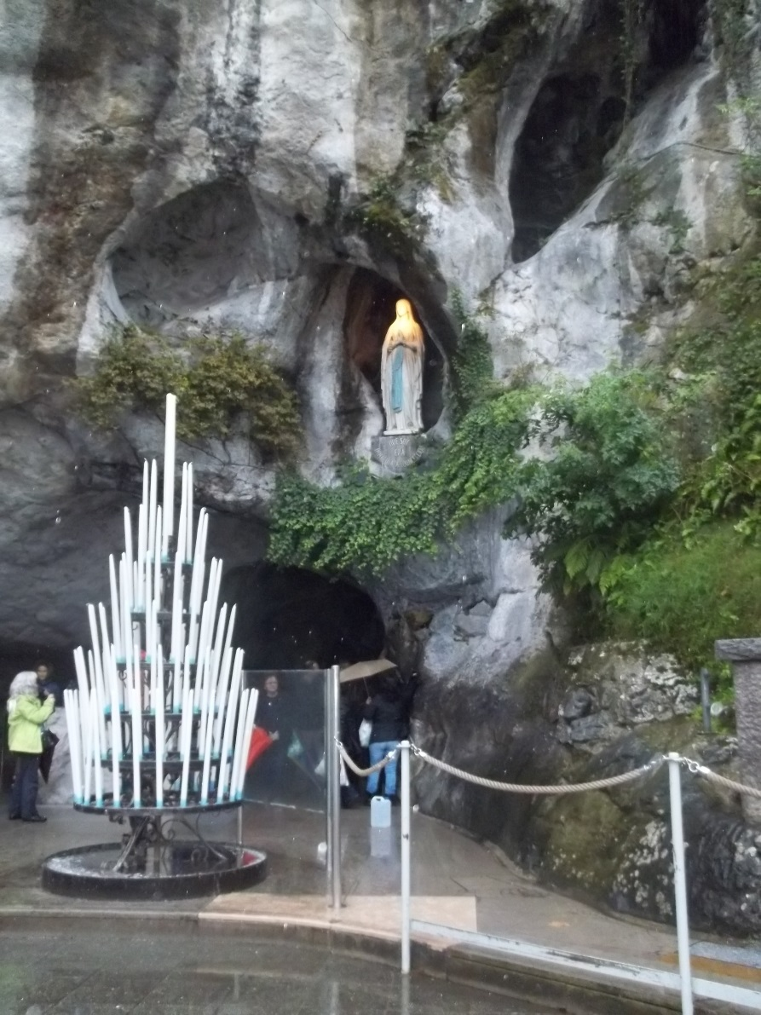
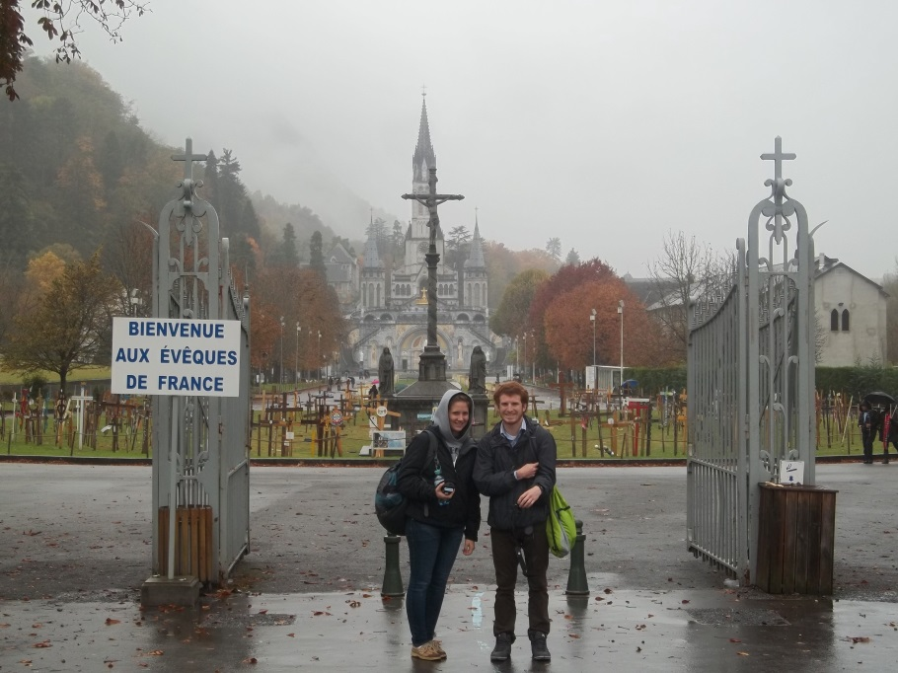

Slide 10
Prayers to Jesus THROUGH Mary
Angelus
Memorare
Rosary
Hail Mary

Slide 11
Part 3: The Magnificat

Slide 12
The Infancy Narratives contain three canticles:
What is a canticle?
  A song

Slide 13
Quick Search
Look in the Infancy Narratives to try to find the three people who said these hymns of praise or “canticles”
  Mary
  Zechariah
  Simeon

Slide 14
Mary’s Magnificat
Luke 1:46-55
Work in groups to reword the Magnificat into your own words or how you think Mary would have said it today. Be respectful and remember that Mary was the Mother of God and would not have said anything offensive.

