Slide 1
Good Morning! Please turn in your homework and prepare for class!

Slide 2
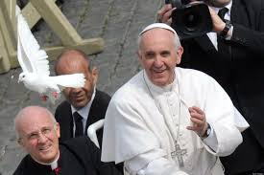
Pope Francis

Slide 3
Pope Francis…
Is the first pope from the Americas
Is the first Pope from the Jesuit order
Is the first Pope to take the name Francis
Has a strong devotion to Mary
Loves to visit the poor
Loves soccer
Speaks: Spanish, Italian, English, French,
and German

Slide 4
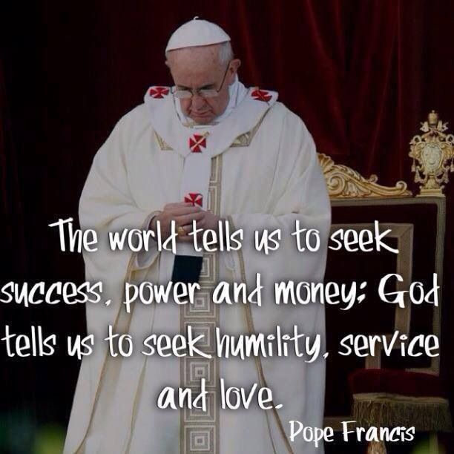

Slide 5
Pope Mobile
Pope washing the feet of teens

Slide 6


Slide 7
Essay Assignment:
Our Holy Father, Pope Francis, has inspired us—through words and deeds, to follow Jesus in serving the poor.
Write an essay explaining what it means to serve the poor and how you see it happening—or not happening—in our world.
  Give examples from your own life or lives of people you know or have heard about. (Examples MUST be true)
  Length- 500-700 words
  Pages must be typed and double-spaced, and stapled.
  Spelling and grammar COUNT.

Slide 8
Essay Assignment:
You need a cover page which looks like this:
Your name and grade
St. Amelia School
2999 Eggert Rd. Tonawanda, NY 14150
(716) 836-2230
Miss Ziarnowski, bziarnowski@stameliaschool.org

Slide 9
Essay Assignment
Outline due October 17th/18th
Rough draft due October 24th/25th
Peer editing October 29/30
Final draft due Oct 31/Nov 1st

Slide 10
Prizes for winning essays:
1st place: $1,000
2nd place: $300
3rd place: $150

