Slide 1
Good Morning! Please take out your Bibles ☺

Slide 2
The fruit of silence is prayer, the fruit of prayer is faith, the fruit of faith is love, the fruit of love is service, the fruit of service is peace. ~Mother Teresa

Slide 3
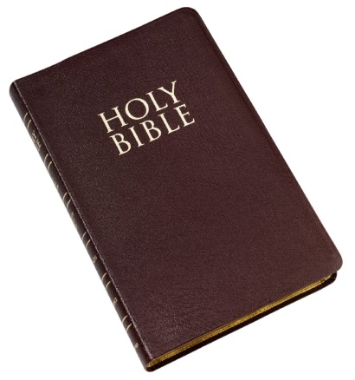
See Matthew 25: 31-46

Slide 4
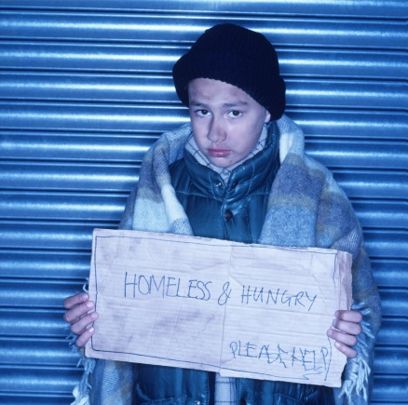
The Corporal Works of Mercy
Kind acts by which we help our neighbors with their everyday material needs. These include: feeding the hungry, finding a home for the homeless, clothing the naked, visiting the sick and those in prison, giving alms to the poor, and burying the dead.

Slide 5
Please work together in groups to complete “A Call to Service”
Ensure all names of group members are on sheet to be turned in

Slide 6
Homework:
Read Galatians 6: 1-10
Read Phillippians 2:3-4
Read Colossians 3:16-17
Write a paragraph (3-5 sentences) describing the attitude needed for Christian service.

