Slide 1
Good Morning! Please take out your Bibles ☺

Slide 2
The fruit of silence is prayer, the fruit of prayer is faith, the fruit of faith is love, the fruit of love is service, the fruit of service is peace. ~Mother Teresa

Slide 3
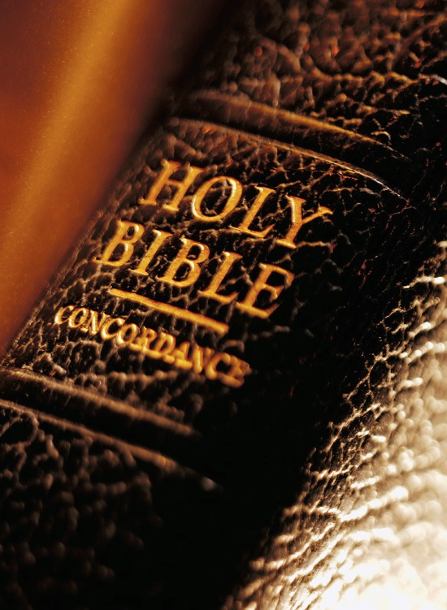
See Matthew 5: 1-12

Slide 4
The Beatitudes:
A set of guidelines for Christlike living that will make us happy and lead us to eternal life.

Slide 5
The Beatitudes:
Blessed are the poor in spirit, for theirs is the kingdom of heaven
Blessed are they who mourn for they will be comforted
Blessed are the meek, for they will inherit the land
Blessed are they who hunger and thirst for righteousness, for they will be satisfied
Blessed are the merciful for they will be shown mercy
Blessed are the clean of heart, for they will see God
Blessed are the peacemakers, for they will be called children of God
Blessed are those who are persecuted for the sake of righteousness, for theirs is the kingdom of heaven.

Slide 6
As a group, work together to answer questions on assigned Beatitude.
Please ensure that the name of every person in your group is on your paper to be turned in.

