Slide 1
Good Afternoon!
Please turn in HW and take Bible off the shelf and to your seat.

Slide 2
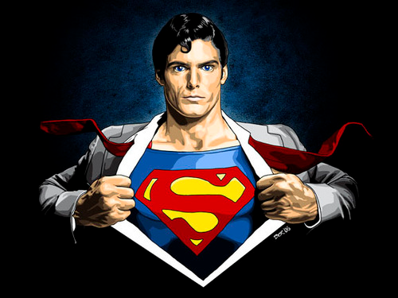
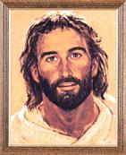
Jesus
Fully God and fully man.

Slide 3
Last lesson, we discussed the 3 mysteries of Jesus…
Today we will talk more about the HUMANITY of Jesus.

Slide 4
A mystery requires:
FAITH
  Faith is defined as believing and trusting when one doesn’t understand.

Slide 5
(p. 9) There are two ways that God reveals Himself
This is referred to as a “deposit of faith”
  SCRIPTURE
  TRADITION

Slide 6
Deposit of Faith
Scripture
  Sacred writings containing God’s Revelation; the written testimony of people’s beliefs.
Tradition
  The Revelation of God through truths handed down by the Church from the time of the apostles in teachings, liturgy, writings, and the lives of Christians.

Slide 7
Tradition vs.
tradition
Essential truths of our Catholic faith
Do not change
  Jesus is Son of God
  True God, true man.
A way of acting that has been practiced for a long time
Can change
  Most children receive Communion in third grade

Slide 8
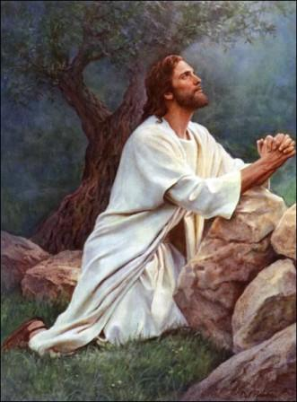
Examples of Christ’s humanity:
Matt. 21:12
Hebrews 5:7-10
John 11: 28-37

Slide 9
For your exit tweet, please write what the difference between tradition and Tradition is
**Remember HW due tomorrow!

