Slide 1
Chapter 7: RCIA: A Community Affair

Slide 2
Last time…
We discussed the 3 categories of the sacraments
  Sacraments of Initiation
  Sacraments of Healing
  Sacraments at the Service of Communion

Slide 3
Today we will look at the process of RCIA
RCIA stands for Rite of Christian Initiation of Adults
  This program is for anyone age seven or older who has not been baptized.
  This rite involves the Sacraments of Initiation

Slide 4
Words to Know
Mystagogy
  The last stage of the RCIA in which the newly initiated reflect on the deep meaning of the sacraments they have celebrated and on living the Christian life fully.
Catechumen
  A person preparing to become a member of the faith community.

Slide 5
Elect
  Those who are formally called to the Sacraments of Initiation during the Rite of Enrollment
Exorcism
  Prayers against the evil spirit that teach us the mystery of sin and how Christ the Redeemer has saved us

Slide 6
Rite of Enrollment
  The ceremony in which catechumens become the elect
Scrutinies
  Petitions and exorcisms that strengthen the catechumens in their decision to live for Christ
Sponsor
  The person who assists the catechumen in his or her journey of faith

Slide 7
See p. 47
Christian Initiation

Slide 8
3 steps of Initiation
CATECHUMENATE
ELECTION
INITIATION

Slide 9
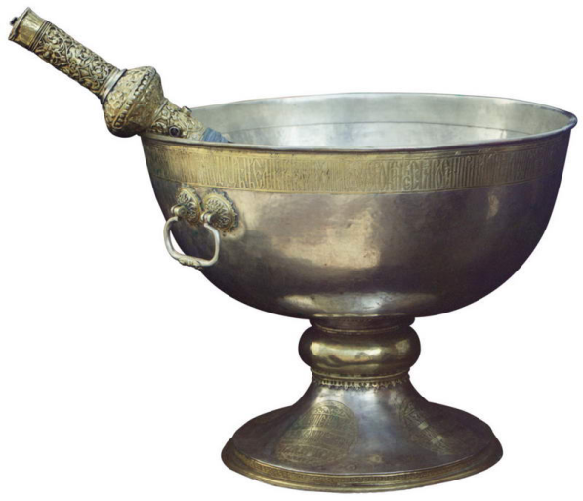
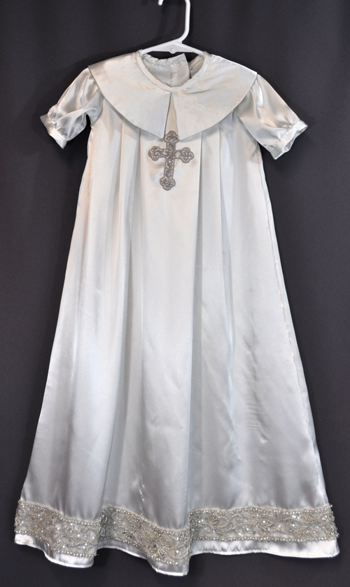
The symbols of RCIA
Water
White Robe

Slide 10


The symbols of RCIA
Candle
Chrism

Slide 11
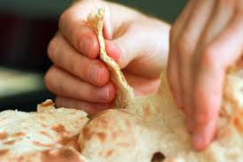

The symbols of RCIA
Bread
Wine

Slide 12
See chart p. 161
(Sacraments of Initiation)

