Slide 1
Chapter 8: Baptism and Confirmation
Signs of Salvation

Slide 2
Motivation Monday!!!!
Kid President

Slide 3
Words to Know
Mystical Body of Christ
  The members of the Church formed into a spiritual body and bound together by the life communicated by Jesus Christ through the sacraments.
Sacrament
  An outward sign of an inward grace instituted by Christ

Slide 4
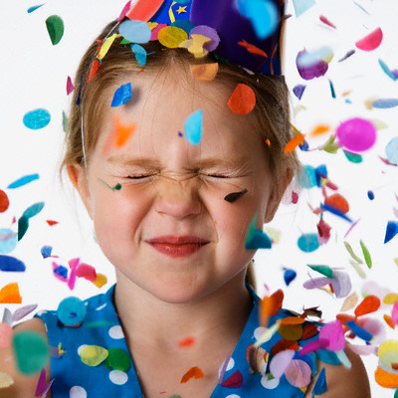
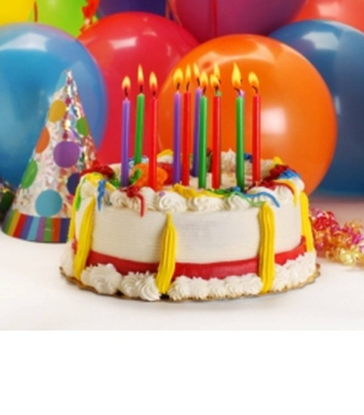
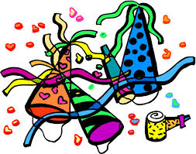
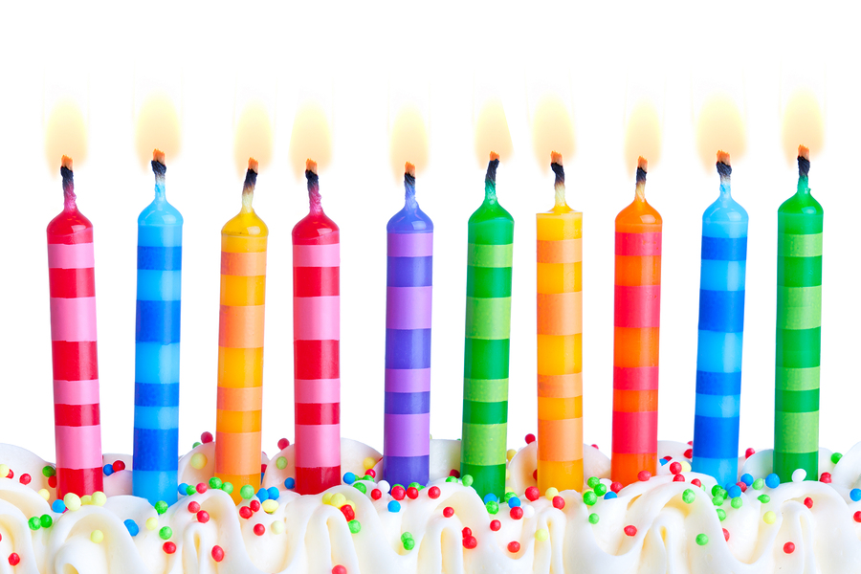
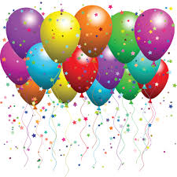

Slide 5
What do the birthday objects and rituals celebrate?
The life of someone we know and love
By themselves, these objects have little meaning
  When they are used as a part of a birthday celebration, we give them special meaning.

Slide 6
Similarly, the sacraments use symbols
Symbols are signs or objects that stand for something
The symbols used in the sacraments are simple and basic.

Slide 7
Sacrament Review…
(Thumbs up if true, thumbs down if false)
There are only three sacraments instituted by Christ
  False
Through meeting Jesus in the sacraments, we receive grace.
  True
Through the sacraments, we come in contact with the saving power of Jesus’ death and Resurrection
  True

Slide 8
The whole believing community is strengthened each time a sacrament is celebrated
  True
How much we benefit from the sacraments depends on our depth of faith and our openness to God
  True
Sacraments do not need visible or outward signs in order to be conferred
  False
Anointing of the Sick is the name of a sacrament
  True

Slide 9
See p. 47- The Seven Sacraments
Why are sacraments important to our relationship with Jesus?
  They deepen our relationship with him. In them we encounter Jesus, who strengthens his divine life in us enabling us to carry out our mission as his disciples.

Slide 10
Celebrating the Sacraments
As with birthday parties, we generally celebrate sacraments as a faith community
The sacraments help us to love and serve others better

Slide 11
3 categories of the sacraments
Sacraments of Initiation
Sacraments of Healing
Sacraments at the Service of Communion
  See chart p. 161

Slide 12
Find the following scripture passages and identify which sacrament each is talking about
Matthew 28:19
Luke 22: 14-20
Mark 10:6-9
Mark 14: 22-25
James 5:13-15
Acts 8:17
John 20:19-23

