Slide 1
The Third Mark of the Church:
The Church is CATHOLIC

Slide 2
We have discussed…
The Church as
  One
  Holy
  Now we will talk about the Church as CATHOLIC
    What does “catholic” mean?
      The word catholic means universal, worldwide, total, for all

Slide 3
The Church is catholic
It strives to preach the good news of salvation to ALL people in every culture and nation
It teaches the total message of Jesus Christ
It offers all that is necessary for salvation
It proclaims the Good News of Christ’s teaching in every age until the end of the world

Slide 4
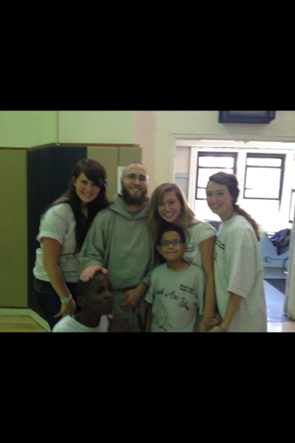
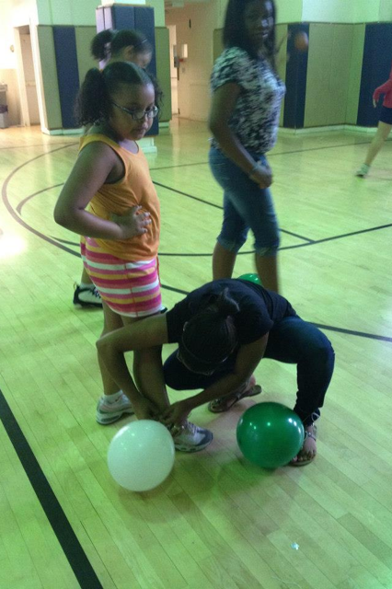

Slide 5
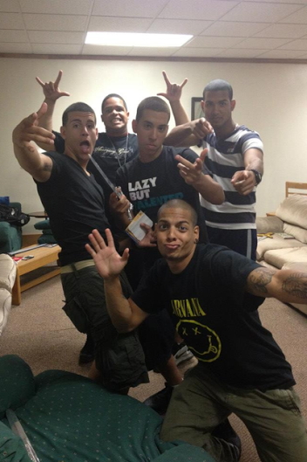

Slide 6
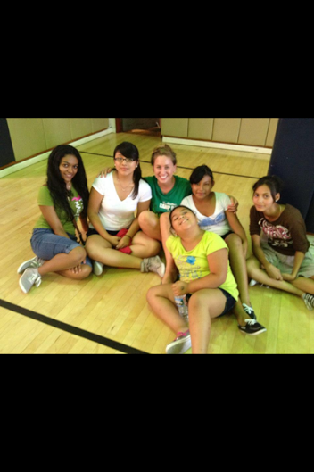
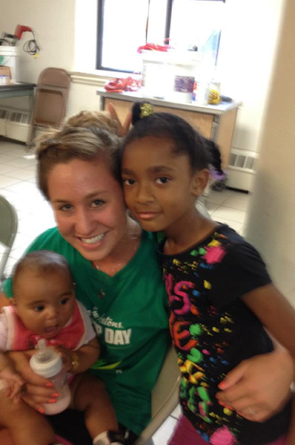

Slide 7
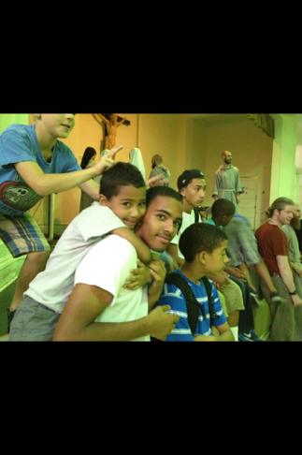
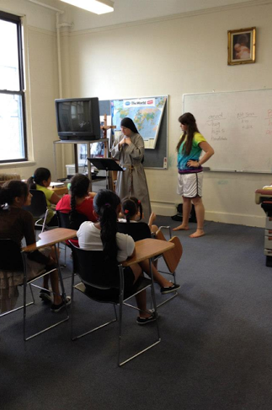

Slide 8
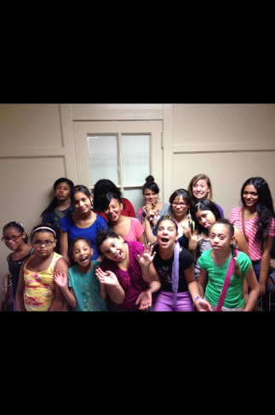
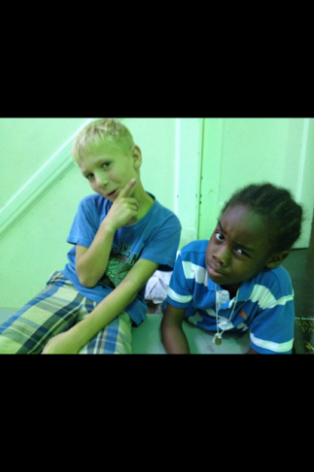

Slide 9
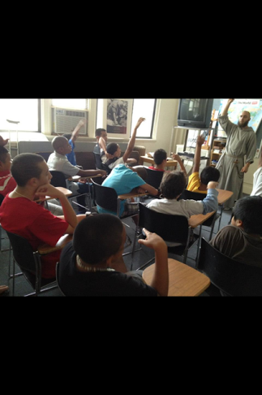
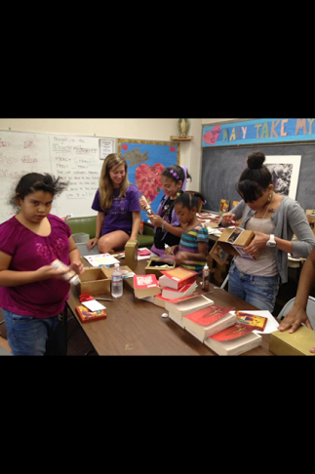
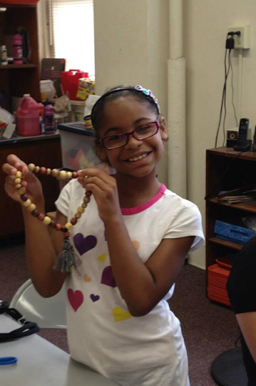

Slide 10
To be catholic…
The Church must teach all that Christ taught, the fullness of the Gospel, the total message.
Popes and bishops must preserve all God’s revealed truth and make sure it is handed down (apostolic succession)

Slide 11
How we relate…
Jewish people maintain the old covenant that God made with Abraham
Islamic people profess to hold the faith of Abraham and adore the ONE God
  The Church believes goodness and truth is present in other religions.
  Interreligious dialogue—when we strive to increase understanding between different religions.

Slide 12
See p. 58: To All Nations

Slide 13
Examples of how a parish is catholic…
An elderly couple moves over to make room for a young family
Masses are celebrated in English and Spanish
A visiting missionary asks for donations
A person near the altar signs for those who are hearing impaired

Slide 14
Try to think of another example of how the parish shows it is CATHOLIC

Slide 15
Mother Teresa says…
"There is only one God and He is God to all; therefore it is important that everyone is seen as equal before God. I’ve always said we should help a Hindu become a better Hindu, a Muslim become a better Muslim, a Catholic become a better Catholic. We believe our work should be our example to people. We have among us 475 souls - 30 families are Catholics and the rest are all Hindus, Muslims, Sikhs—all different religions. But they all come to our prayers."

