Slide 1
Thankful Thursday
What about your faith are you most thankful for?

Slide 2
What are the 4 marks of the Church?
One
Holy
Catholic
Apostolic

Slide 3
Today, we will look at how the Church is ONE
One in Faith
One in Worship
One in Governance
One in Charity

Slide 4
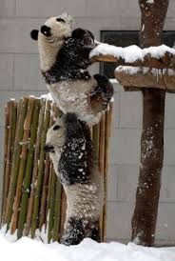
How is unity achieved?
By sharing the same convictions, values, vision, and goals

Slide 5
See p. 44

Slide 6
One in FAITH
We are one in what we believe
As Catholics, we believe Jesus is Lord
We express our ONE belief through creeds
Make flip book

Slide 7
Continue through worship, governance, and charity
conversion

