Slide 1
Happy Monday!
Motivation Monday :)

Slide 2
A People of Prayer
Chapter 4: What is Prayer?

Slide 3
Words to Know
Liturgy of the Hours—the public prayer of the Church to praise God and to sanctify the day. It includes an office of readings before sunrise, morning prayer at dawn, evening prayer at sunset, and prayer before going to bed.
Prayer—the raising of our hearts and minds to God. We are able to speak to and listen to God in prayer because he teaches us how to pray.

Slide 4
Last time…
We talked about how the Spirit came to the disciples while they were at prayer.
Prayer was also one of the characteristics of the early community.

Slide 5
What was the most dangerous experience you’ve ever had?
People often pray when they are in difficult circumstances.
Why should we pray when we are in trouble or danger?

Slide 6
Types of Prayer:
Adoration
Contrition
Thanksgiving
Supplication

Slide 7
See p. 24
What is prayer compared to?
  breathing
What are the two kinds of prayer mentioned here?
  Personal and communal
How is Jesus a model for prayer?
  He prayed meal prayers, the Psalms, the Shema, etc.

Slide 8
Prayer requires listening
A listening heart is vital
We shouldn’t be doing all of the talking
2564 Christian prayer is a covenant relationship between God and man in Christ. It is the action of God and of man, springing forth from both the Holy Spirit and ourselves, wholly directed to the Father, in union with the human will of the Son of God made man.
-Catholic Catechism

Slide 9
2596 The Psalms constitute the masterwork of prayer in the Old Testament. They present two inseparable qualities: the personal, and the communal. They extend to all dimensions of history, recalling God’s promises already fulfilled and looking for the coming of the Messiah.
-Catholic Catechism

Slide 10
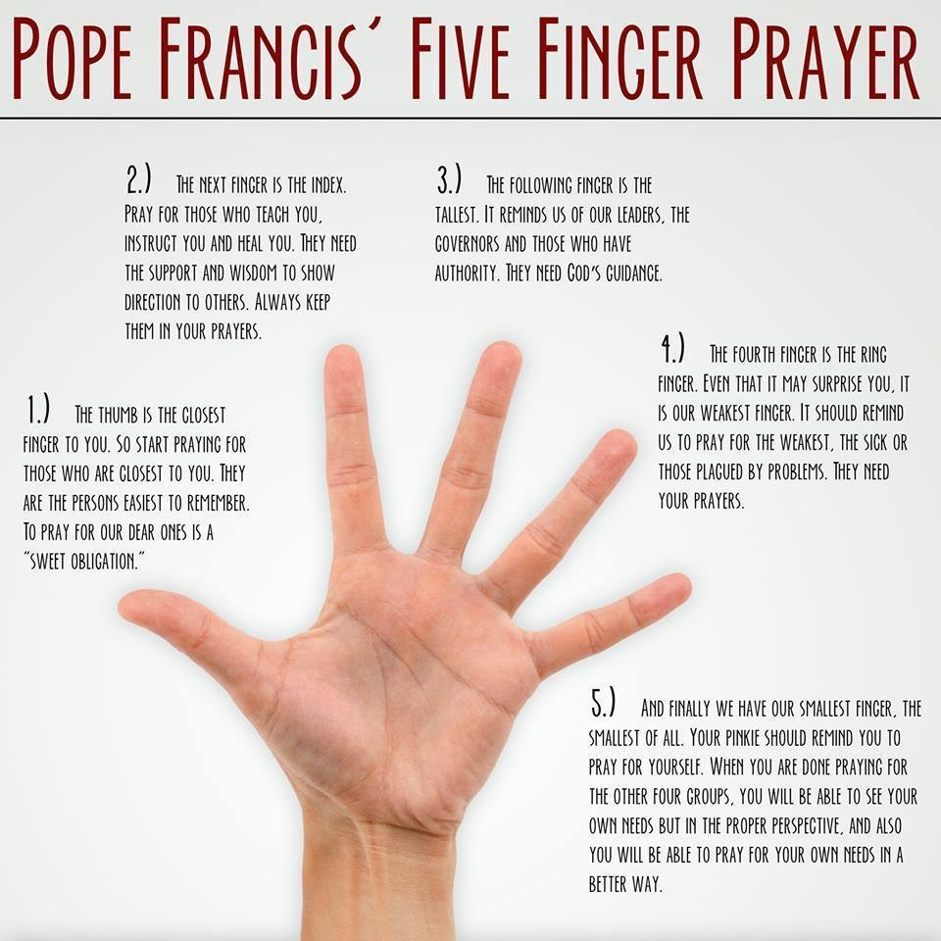

Slide 11
Exit Tweet
What are the 4 types of prayer? (ACTS)

