Slide 1
Let nothing disturb you,
Let nothing frighten you,
All things are passing away:
God never changes.
Patience obtains all things
Whoever has God lacks nothing;
God alone suffices
-St. Teresa of Avila

Slide 2
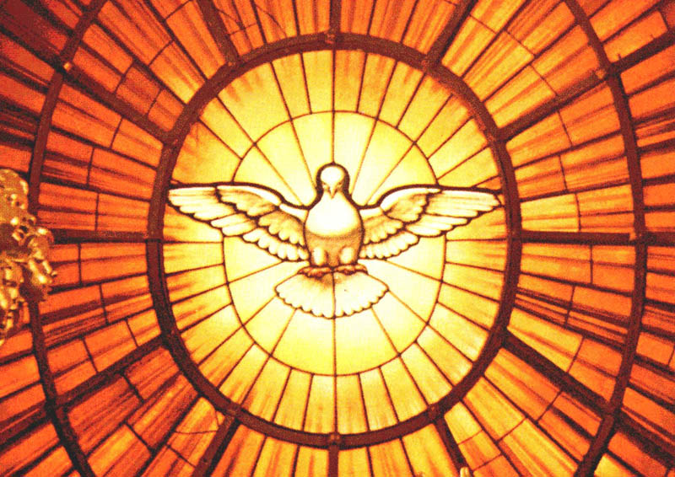
The origins of the Church
The coming of the Holy Spirit

Slide 3
Prior to jesus’ death
There was a small following of disciples listening and learning from Jesus.

Slide 4
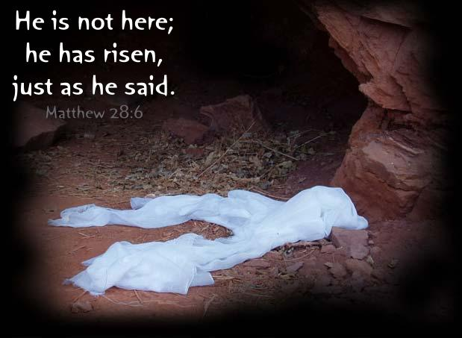
What event made the disciples want to evangelize and spread Christianity?
The Resurrection!

Slide 5
After hE rose…
Jesus told the disciples to await the Holy Spirit
The Holy Spirit came in the form of wind and tongues of fire
This day is known as Pentecost
  Pentecost is referred to as the “birthday of the Church”

Slide 6
See Acts 2:1-41

Slide 7
The beginning of the church
The early Christian communities were one:
  In their belief in Jesus and His teaching
  In the Eucharist
  In prayer
  In their love for one another

Slide 8
In small groups…
Present a breaking news reporter-style story about Pentecost
Design a bulletin board display about the early Christian community
Write and enact a play about the meeting of early Christians
  See Acts 4:32-35, Acts 5:12-16

