Slide 1
Good Morning!
You do Not need to take out your bibles, please take out the word of god paper ☺

Slide 2
Who belongs to the Church?
The Catholics in your own parish
Billions of baptized Catholics around the globe
Those preparing to be baptized—known as catechumens
Those in Heaven—the community of Saints
Those in Purgatory

Slide 3
Church Militant
  Those on earth
Church Suffering
  Those in Purgatory
Church Triumphant
  Those in heaven

Slide 4
How do these three parts of the Church interact?
The church militant can pray for the souls in purgatory
The blessed in heaven can intercede for us and those in purgatory

Slide 5
Can people go to heaven even if they are not Catholic?
Yes
Anyone who believes in God and avoids sin can be a saint

Slide 6
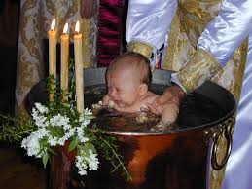
Those related to the Church
Baptized members of Christian churches

Slide 7
Other faiths related to Catholicism
The Jewish faith
Islam
Buddhism

Slide 8
Live up to your potential! Sheet

