Slide 1
Beyond the Gospels
New Testament cont.

Slide 2


Slide 3
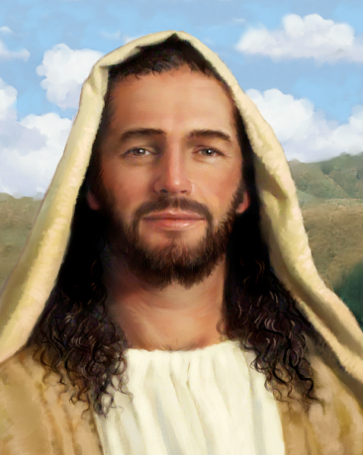
What is the purpose of the Gospels?
To learn about Jesus, his life, friends, and actions
The Gospel is the Good News that Jesus’ life, death, and Resurrection have freed us from the power of sin and death.

Slide 4
God inspired all the books of the Bible
What is Inspiration?
The action of God that moves people to communicate what God wants made known, using their own background, culture, language, and style.

Slide 5
How is inspiration for an English assignment different from biblical inspiration?
Inspiration for an assignment is a natural idea
Biblical inspiration is from God and reveals him to us.

Slide 6
See p. 18 “Other Inspired Books”

Slide 7
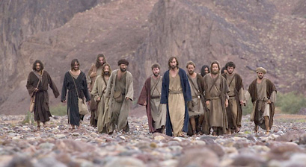
Acts of the Apostles:
How Peter, Paul, and the other disciples founded the first Christian communities; the progress of Christianity from Jerusalem to Rome

Slide 8
Letters
Written by
  Paul
  Also known as
    Epistles
    Mostly About:
      Issues about being a Christian in a Roman world

Slide 9
Revelation
Uses symbols
Is strange and difficult to read

Slide 10
Exit Tweet
What is the difference between Inspiration and inspiration?

