Slide 1
GOOD MORNING!
Jean ValJean

Slide 2
What is Mercy?
According to Webster’s Dictionary:
Mercy is: kind or forgiving treatment of someone who could be treated harshly
: kindness or help given to people who are in a very bad or desperate situation
: a good or lucky fact or situation

Slide 3
Divine Mercy

Slide 4
St. Faustina
In February, 1931, a Polish nun who began receiving messages and visions from Jesus
He requested:
  that she create a painting depicting his divine mercy flowing from His sacred heart
  that a feast day for His Divine Mercy be established on the first Sunday after Easter.

Slide 5
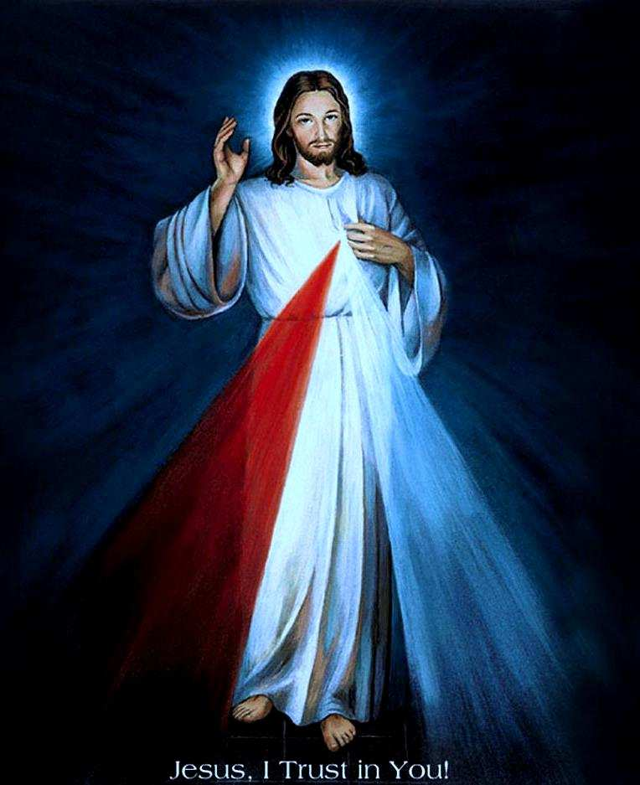
The message of Divine Mercy
God’s mercy is greater than our sins.
Ask for mercy
Be merciful
Completely trust
the promise of Divine Mercy

Slide 6
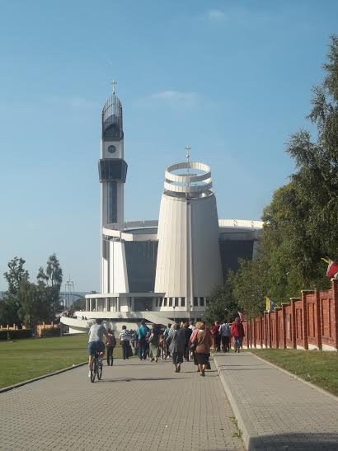

Slide 7
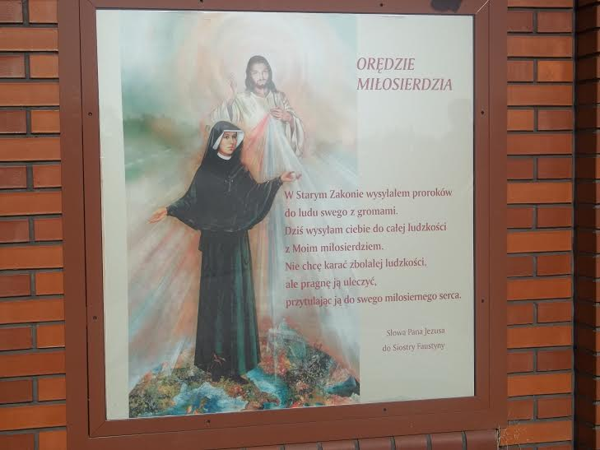

Slide 8
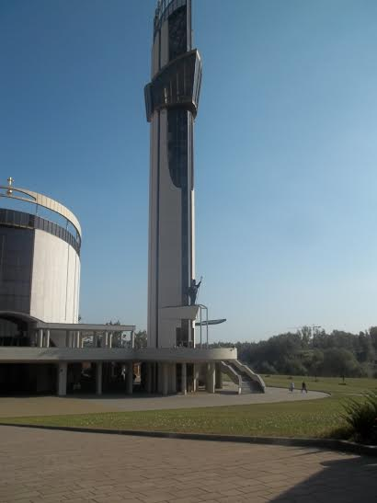

Slide 9
Essay Assignment
THEME: Pope Francis has declared Dec. 8, 2015 to Nov. 20, 2016, a Jubilee Year of Mercy. He asks us to focus on following the example of God the Father, who, Jesus says, does not judge us harshly but offers us love and forgiveness.
DIRECTIONS: Write an essay, sharing a real-life story of mercy that has inspired you. What does this story teach you about the need for mercy in our world today?
LENGTH:
500–750 words. Pages should be typed or neatly handwritten in ink and stapled. Note: Spelling and grammar count.
DUE: OCT. 26th

Slide 10
